Slide 1
AHB Protocol
Name: G Vamsi Girish
M.Tech: VLSI System, NIT Trichy.

Slide 2
Protocol
a set of rules or procedures for transmitting data between electronic devices, such as computers.
Why its needed?
Protocol it needed for interact with each component in on-chip SOC.
Example: How to interact processor to USB driver or printer without connects. We can’t tell directly to processor do some operation.
Types of protocols
1.ON-Chip : mostly we will use parallel communication in SOC
limitation: frequency limitations due to skew. example: AXI,APB,AHB
2.Peripheral protocol : mostly we will use series protocol.
Limitation: number of I/O ports.
example: PCIE,USB,DDR, interrupt controller, SPI.

Slide 3
AMBA AHB BUS
AHB is a new generation of AMBA bus which is intended to address the requirements of high-performance synthesizable designs.
High-performance system bus that supports multiple bus masters and provides high-bandwidth operation.
Arbitration:
The arbitration mechanism is used to ensure that only one master has access to the bus at any one time.
The arbiter performs this function by observing a number of different requests to use the bus and deciding which is currently the highest priority master requesting the bus.
Interconnect:
physical or logical connection between two electronic devices or networks.
Interconnect having decoding and multiplexer …etc.

Slide 4
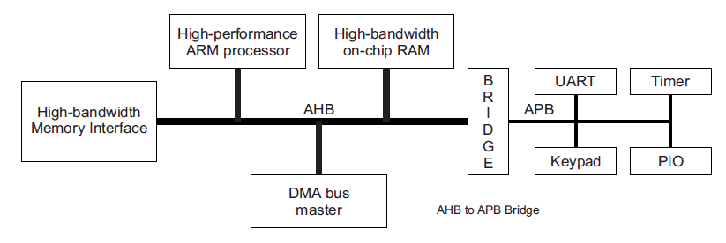
AHB BUS Architecture:
Three types:
A(Application series): AXI
M(Embedded series) : AHB
Real series : AHB
High performance
Pipelined operation
Burst transfers
Multiple bus masters
Split transactions
Low power
Latched address/control
Simple interface
Suitable of many peripherals

Slide 5
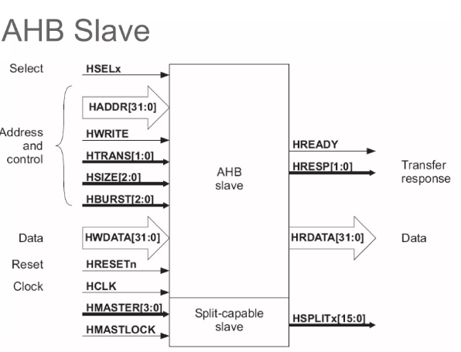
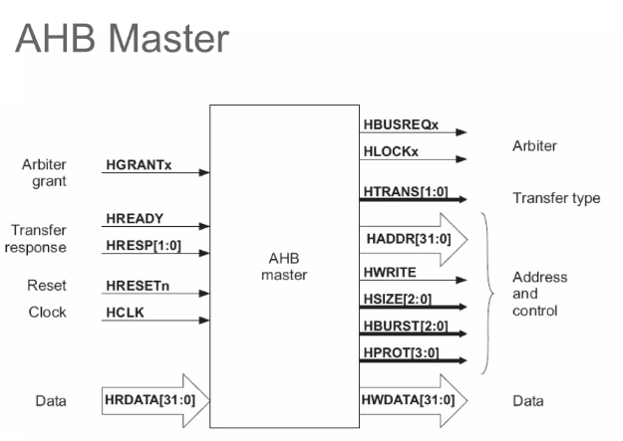
HTRANS
HBURST
HMASTER
HMASTLOCK

Slide 6
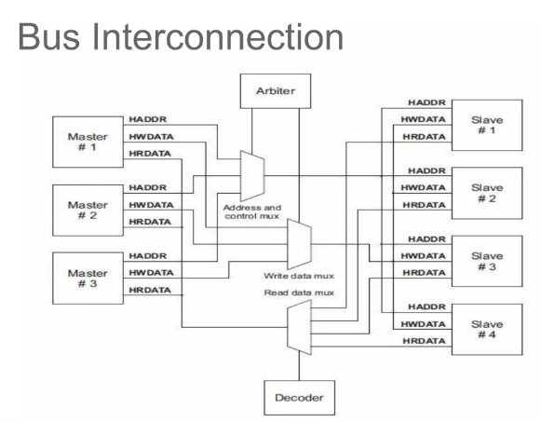
AHB BUS interconnection :
In AHB bus Data can transfer in three phases
1. arbitration face
2. address phase
3. Data phase.
Address phase
1. In this phase, we will provide address of slave and control signal.
Data phase
2. in this phase, data will write to slave or retrieve from slave based on HREADY signal.
3. wait state is also possible in AHB protocol.

Slide 7
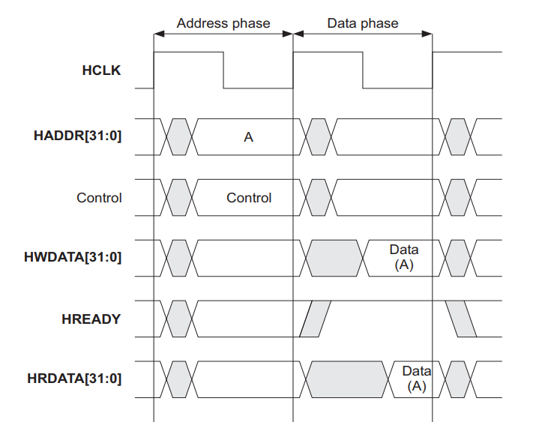

Basic transfer:
Assume, before first positive edge arbitration phase is completed.
The first positive edge there is no data and address as well.
This we called as IDEAL state.
Next clock cycle, 32-bit address and control signals are available. This phase is called address phase.
Next clock cycle, data written to target or retrieve from target happen. This phase is called data phase.
Here is no wait state are available.
1

Slide 8
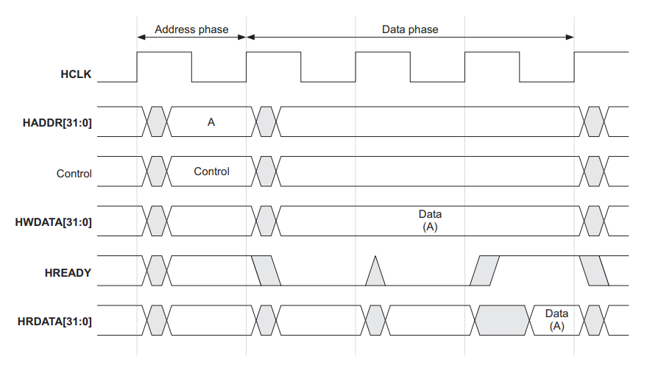

Data transfer with wait state:
Control signal tells slave how many bits of data is sent
HREADY selects whether it will be read or write
APB Master to slave two clock-cycles hence to transfer 50 bits, we need 100 clock cycles
For AHB to transfer 50 bits we need only 51 clock cycles, hence increase in speed

Slide 9
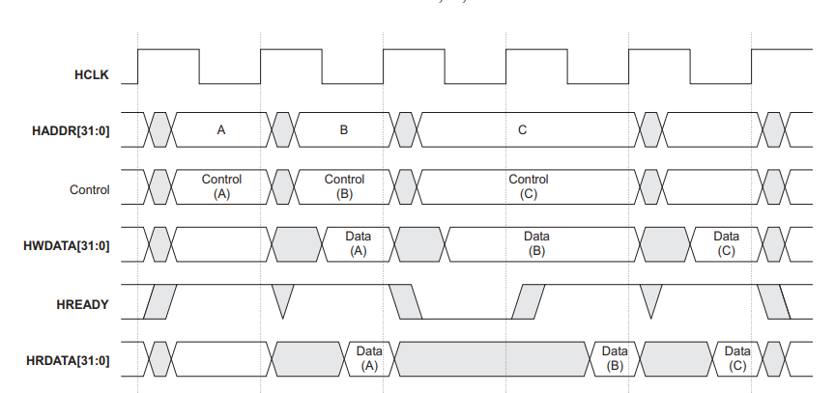
Multiple Data transfer with wait state pipeline
Note here that when A Data is transferred, B Address is communicated hence pipelining occurs and thus there is no Wait statement.
Address and Data is transferred concurrently. Only first transfer needs two clock cycles.
Hence to transfer 20 bits we need only 21 cycles.
In RISC processor we send multiple data and address concurrently.
This is the application of non-blocking statement → Concurrent transfer

Slide 10
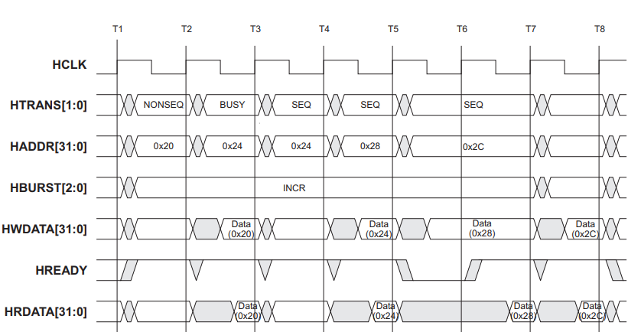
Transer type:
Every transfer can be classified into one of four different types, as indicated by the HTRANS[1:0] signals
00-IDEAL: the state is which there is data transfer happen.
01-BUSY:the state it which ideal cycles are allowed in middle of burst transfer.
10-NON-SEQE: the state is which transaction start begin. This state there is no previous address and control signal.
11-SEQUE: the state it which address and control signal previous values.
Read and Write does not happen simultaneously
Note it is shown in the Figure that read and write happens simultaneously but it is Not like that.
When HBURST is high the HADDR gets incremented by number of bits mentioned in GREPPING_BITS for each clock cycles. But if HTRANS has BUSY Seq then the HADDR will not get incremented and continue to next clock cycle

Slide 11
Transer type Continue …:
Every transfer can be classified into one of four different types, as indicated by the HTRANS[1:0] signals
00-IDEAL: the state is which there is data transfer happen.
01-BUSY:the state it which ideal cycles are allowed in middle of burst transfer.
10-NON-SEQE: the state is which transaction start begin. This state there is no previous address and control signal.
11-SEQUE: the state it which address and control signal previous values.
Notice to enable HBURST mode, first two cycles should be NONSEQ and BUSY. After that only SEQ mode starts where tranfers happens in INCR mode, incrementing address by 4 bytes.
This 4 bytes is controlled by HBURST bit

Slide 12
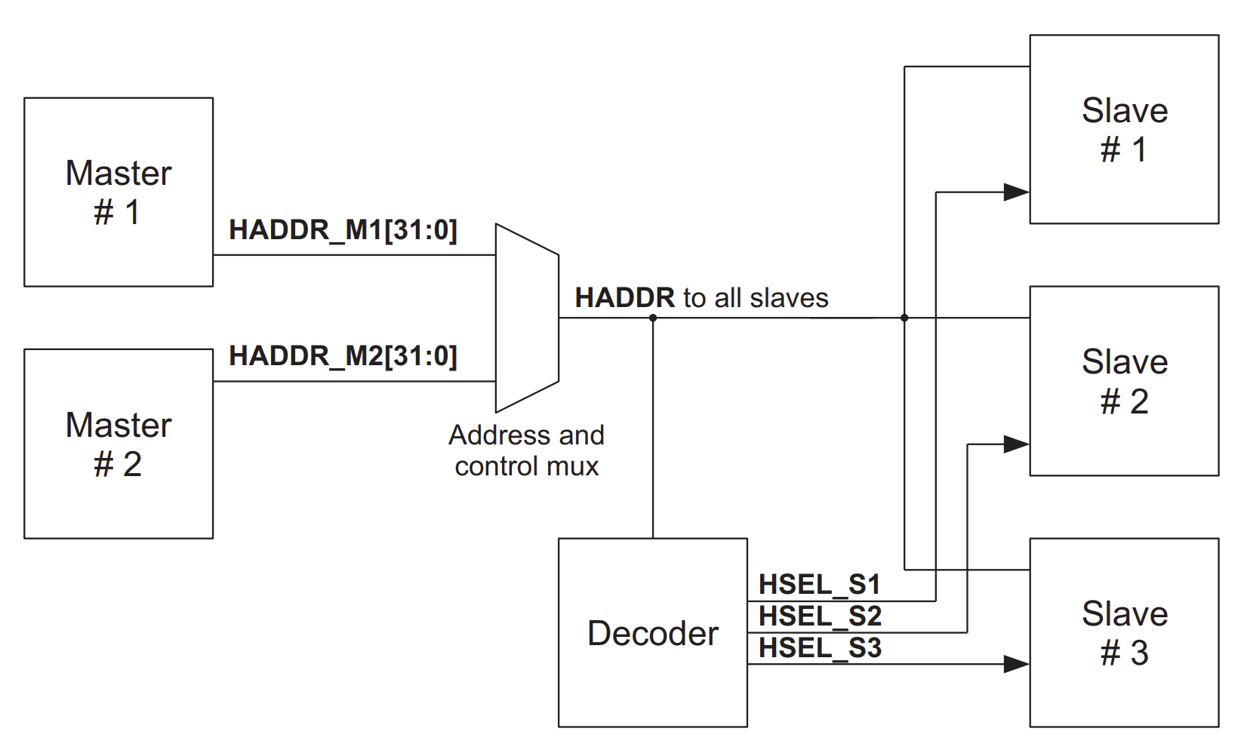
Address decoding
central address decoder is used to provide a select signal, HSELx, for each slave on the bus.
The select signal is a combinatorial decode of the high-order address signals, and simple address decoding schemes are encouraged to avoid complex decode logic and to ensure high-speed operation.
A slave must only sample the address and control signals and HSELx when HREADY is HIGH, indicating that the current transfer is completing.
Under certain circumstances it is possible that HSELx will be asserted when HREADY is LOW, but the selected slave will have changed by the time the current transfer completes.

Slide 13
Slave transfer responses HRESP[1:0]
After a master has started a transfer, the slave then determines how the transfer should progress.
Whenever a slave is accessed it must provide a response which indicates the status of the transfer.
The HREADY signal is used to extend the transfer and this works in combination with the response signals, HRESP[1:0], which provide the status of the transfer
The slave can complete the transfer in a number of ways. It can: • complete the transfer immediately • insert one or more wait states to allow time to complete the transfer • signal an error to indicate that the transfer has failed • delay the completion of the transfer, but allow the master and slave to back off the bus, leaving it available for other transfers.
00 –indicate OKEY response
01-indicate error response(A two-cycle RETRY response is required)
10-indicate retry response(A two-cycle RETRY response is required)
11-indicate splite response(A two-cycle RETRY response is required).

Slide 14
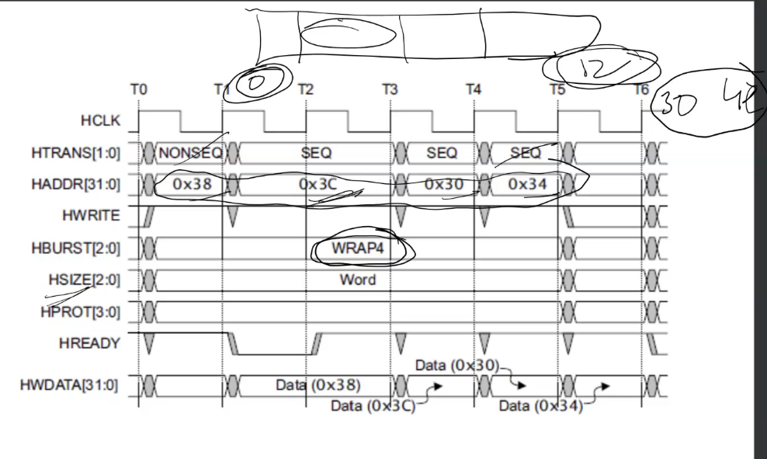
WRAP4 can enable storing only 4 bytes. Over here from 0x30 to 0x3C in 4 bytes.
Wrapping is creating boundary conditions for storing the data.
We only store data in these boundary conditions in chunks of 4 bytes.
Note that these 4 bytes can store in any order unlike in INCR mode. Notice the addr of those locations 0x38, 0x3C, 0x30, 0x34.
Note that INCR and WRAP cannot happen simultaneously.

Slide 15
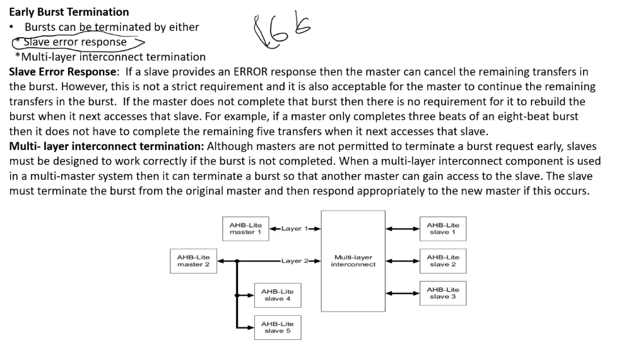
Slave error response -> slave can
Multi-layer interconnect termination -> As multiple slaves are connected using multiple interconnects if slave does not get the correct data it will generate an multi-layer interconnect termination response.
Every transaction happens with CRC encoding and decoding.

Slide 16
Error Response - 2 clock cycle retry response is needed because when data received by slave is
wrong (checked by CRC) then the same address needs to be repeated again
Retry Response – When the slave is occupied by the HLOCK from one master, slave will give SPLIT response to
other masters trying to access the slave

Slide 17
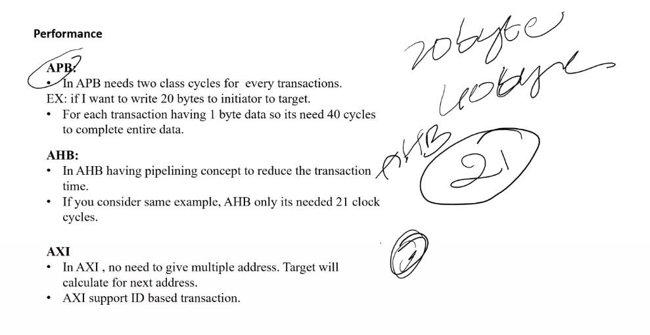
Slave calculates next address in AXI. It does ID based transaction. Different application has different ID’s.
ID response is provided for each transaction in AXI

Slide 18
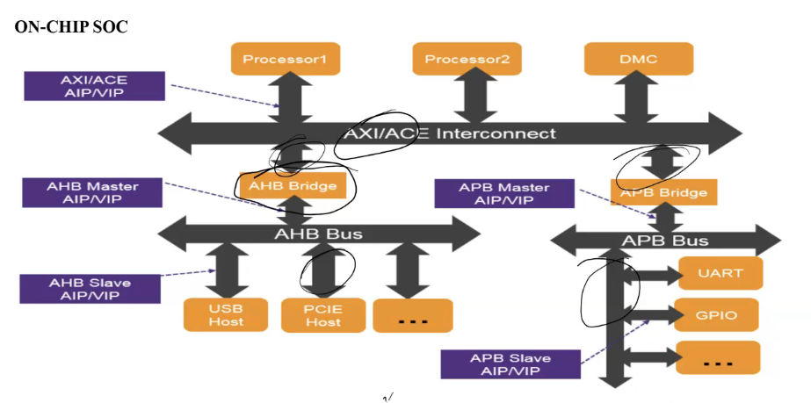
AHB works at 100MHz, AXI works at 500MHz. Hence AHB bridge is used

Slide 19
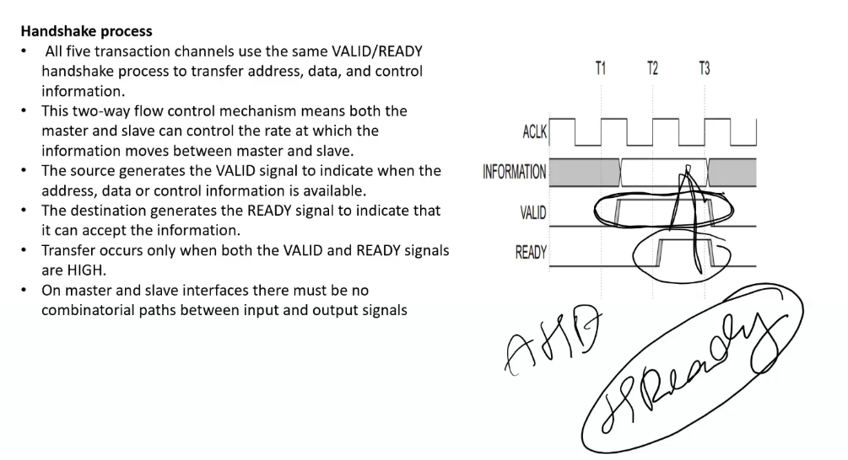

Slide 20
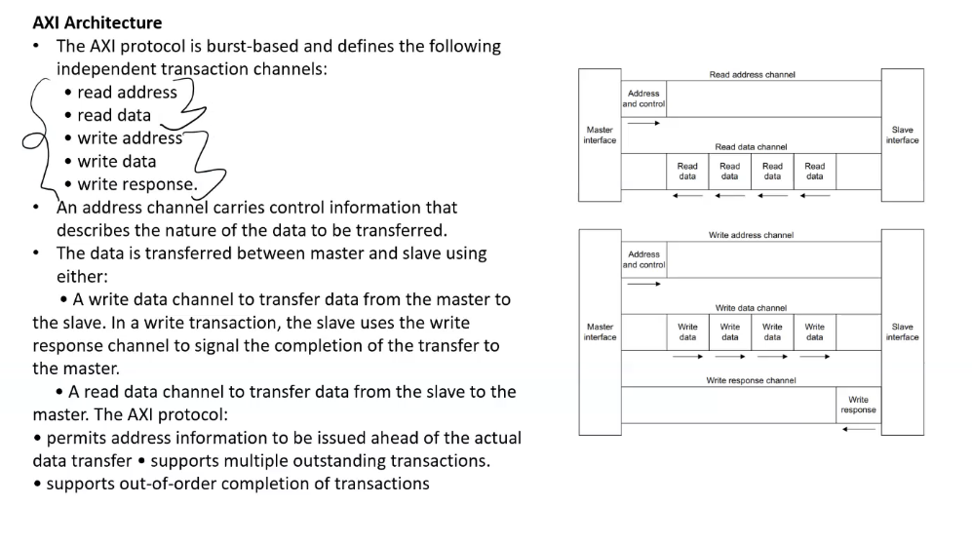

Slide 21
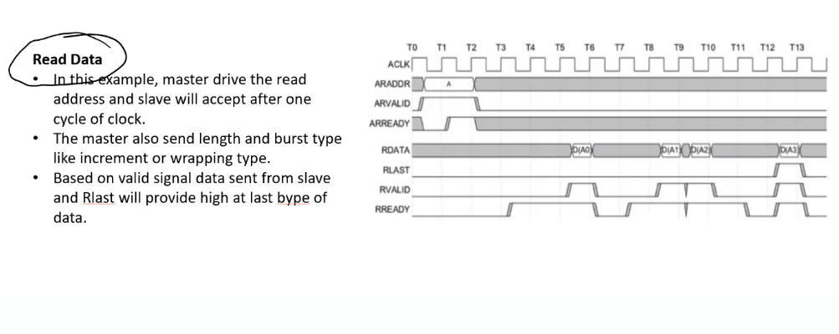
Slave is intelligent will decide the BURST or INCR mode

Slide 22
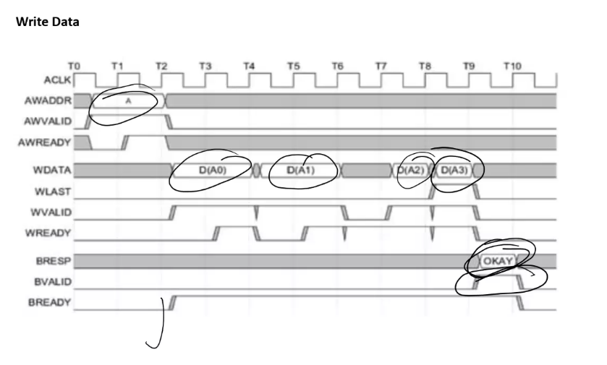
ADDR is not required for AXI. Address gets incremented automatiocally
Pipelining used in AXI too

